Slide 1
Microservice Solution: Tools, Patterns & Practices
Halil İbrahim Kalkan

Slide 2
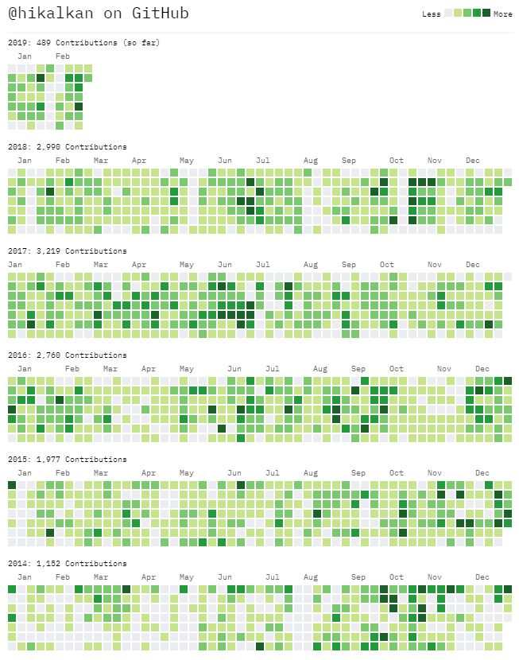

About Me
Halil İbrahim Kalkan
Web: halilibrahimkalkan.com
Github: @hikalkan
Twitter: @hibrahimkalkan

Slide 3
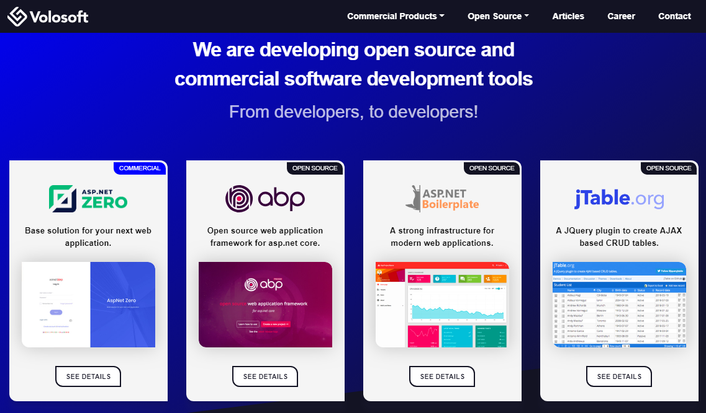

Slide 4
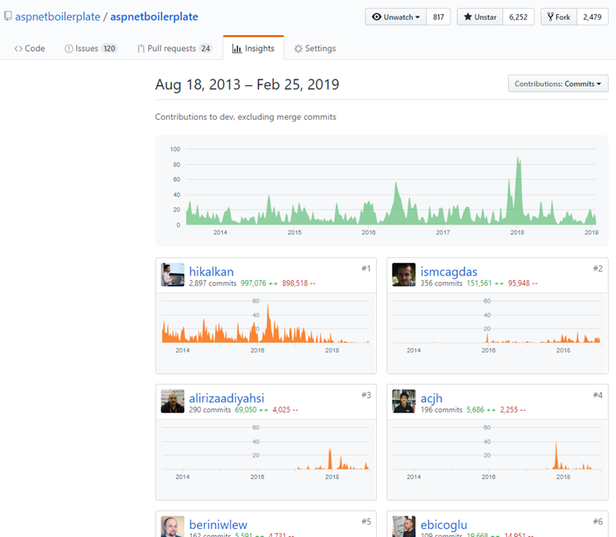
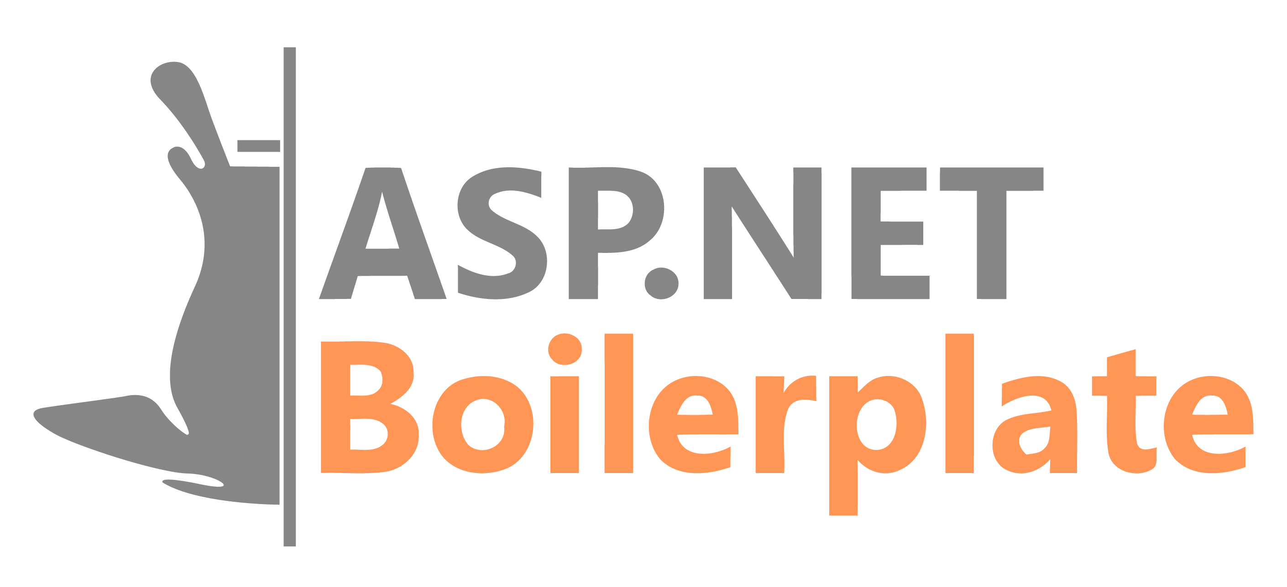
ASP.NET Boilerplate
6.000+ stars on GitHub
1.000.000+ downloads on Nuget
Visit https://aspnetboilerplate.com

Slide 5
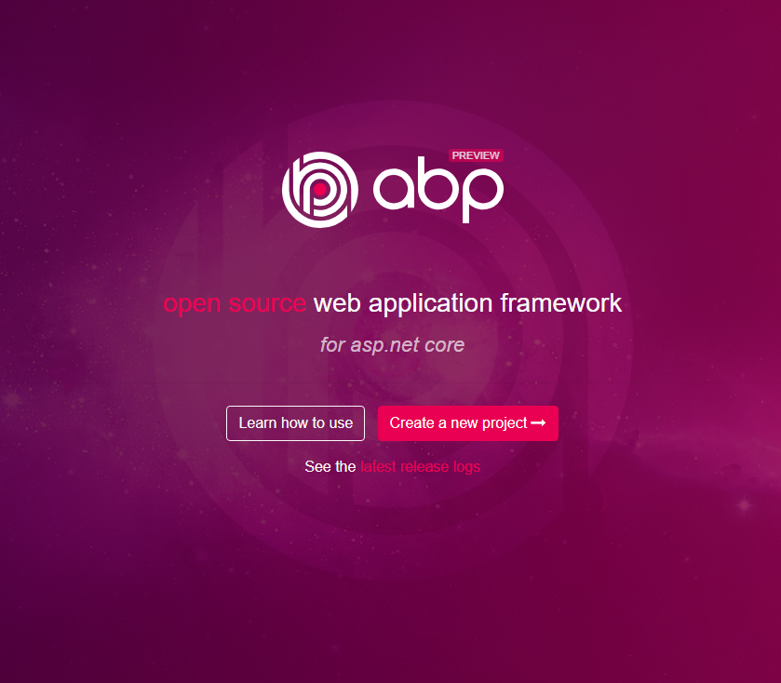
ABP vNext
Visit https://abp.io
Modular architecture
Microservice focused
Domain Driven Design
Multi-Tenancy
Virtual File System
Dynamic Forms & Tag Helpers
Theming
Background jobs
Dynamic HTTP Client Proxies
Database Agnostic
…

Slide 6
Agenda
Part-I: From Monolithic to Microservice: Challenges of the Distributed Architecture
Part II: The Implementation
Part III: Microservice compatible, layered module development model
Part IV: Running on docker containers

Slide 7
Part-I From Monolithic to Microservice Challenges of the Distributed Architecture

Slide 8
Part-I: From Monolithic to Microservice Simple Monolithic Application
Single programming language/platform
Dependency Injection & simple method calls.
Easy to create database transaction scopes.
In-process & transactional messaging / event bus.
Monolithic Application
(UI, APIs, Services, DTOs, Entities, Repositories…)
Single Database

Slide 9
Part-I: From Monolithic to Microservice Layered Monolithic Application
Organize codebase better by layering
Domain Driven Design (DDD) offers four fundamental layers:
Domain Layer
Application Layer
Presentation Layer
Infrastructure Layer
Infrastructure
Layer
Presentation Layer
Application Layer
Domain Layer
Single Database

Slide 10
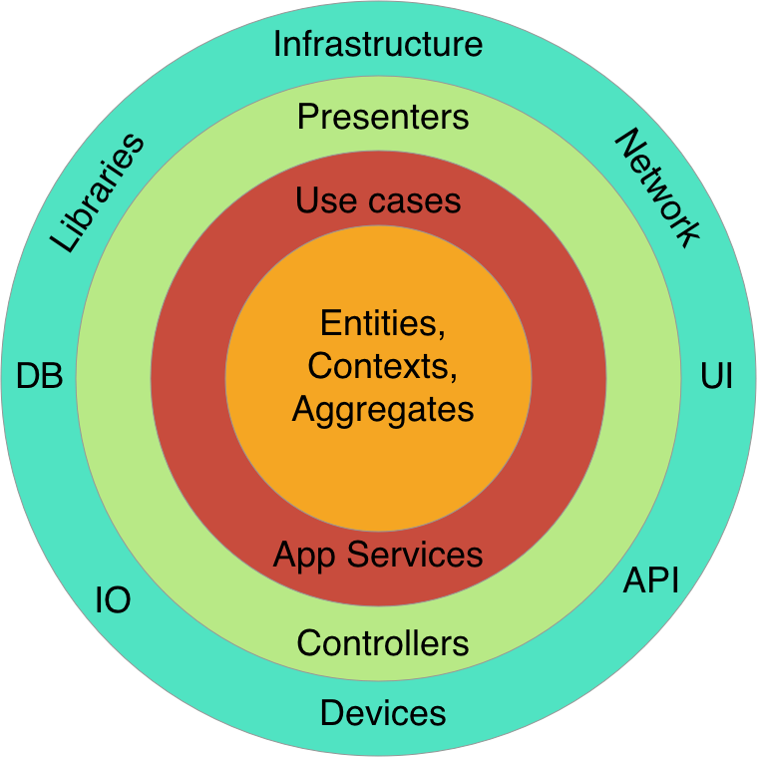
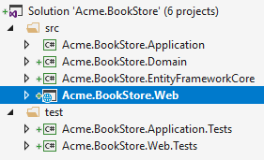
Part-I: From Monolithic to Microservice Layered Monolithic Application
Clean Architecture / Onion Architecture
Each layer can only depend on the layer directly inside it
More organized, maintainable, reusable & testable code base.
Each layer can be a separated project (csproj file)

Slide 11
Part-I: From Monolithic to Microservice Modular Application
Monolithic Application
Each module corresponds to a bounded context in DDD.
Modules can have a separated VS solutions
Modules can cross-reference to each other
Modular in development, but still monolithic on runtime.
A module can be layered inside it.
All modules shares a single database.
Module - 1
Module - 2
Module - 3
Module - 4
Module - 5
Module - 6
Single Database

Slide 12
Part-I: From Monolithic to Microservice Modular Application / Separated Databases
Monolithic Application
Database 1
Module - 1
Module - 2
Database 2
Database 1
Module - 3
Module - 4
Database 5
Database 1
Module - 5
Module - 6

Slide 13
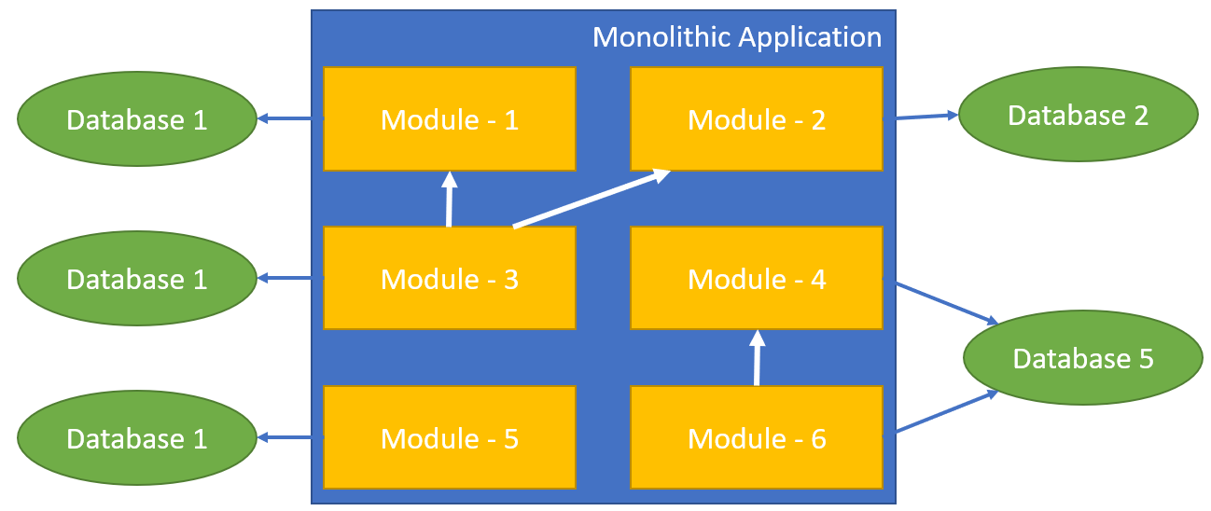
Part-I: From Monolithic to Microservice Modular Application / Separated Databases
Benefits
Better Scalability
Each database gets less load
Each database can be scaled independently
Schema Changes only affects the related module
Challenges
Cross-database joins is hard or impossible
Inter-module method calls
Data duplication / denormalization
Summary tables
Requires distributed transactions
But not supported by all database systems.

Slide 14
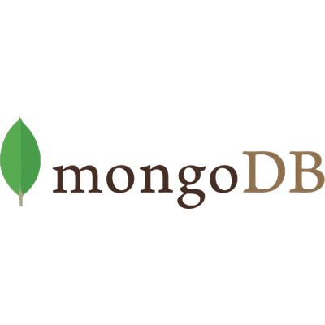

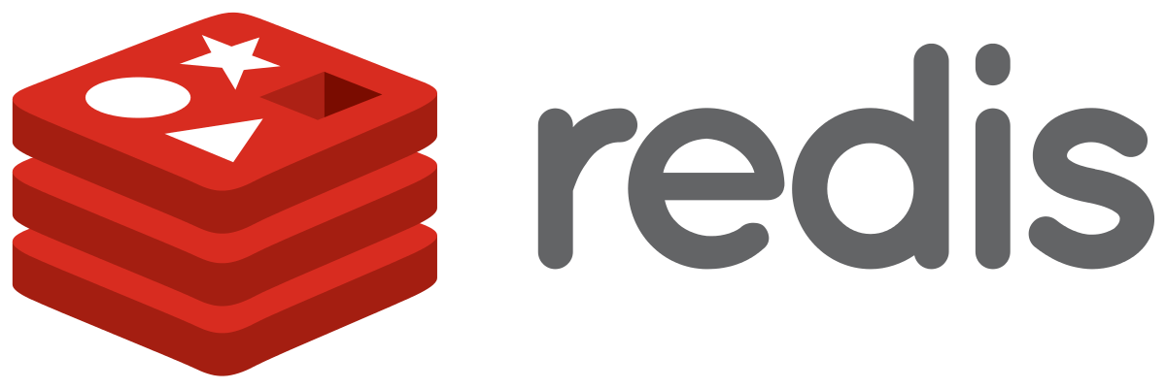
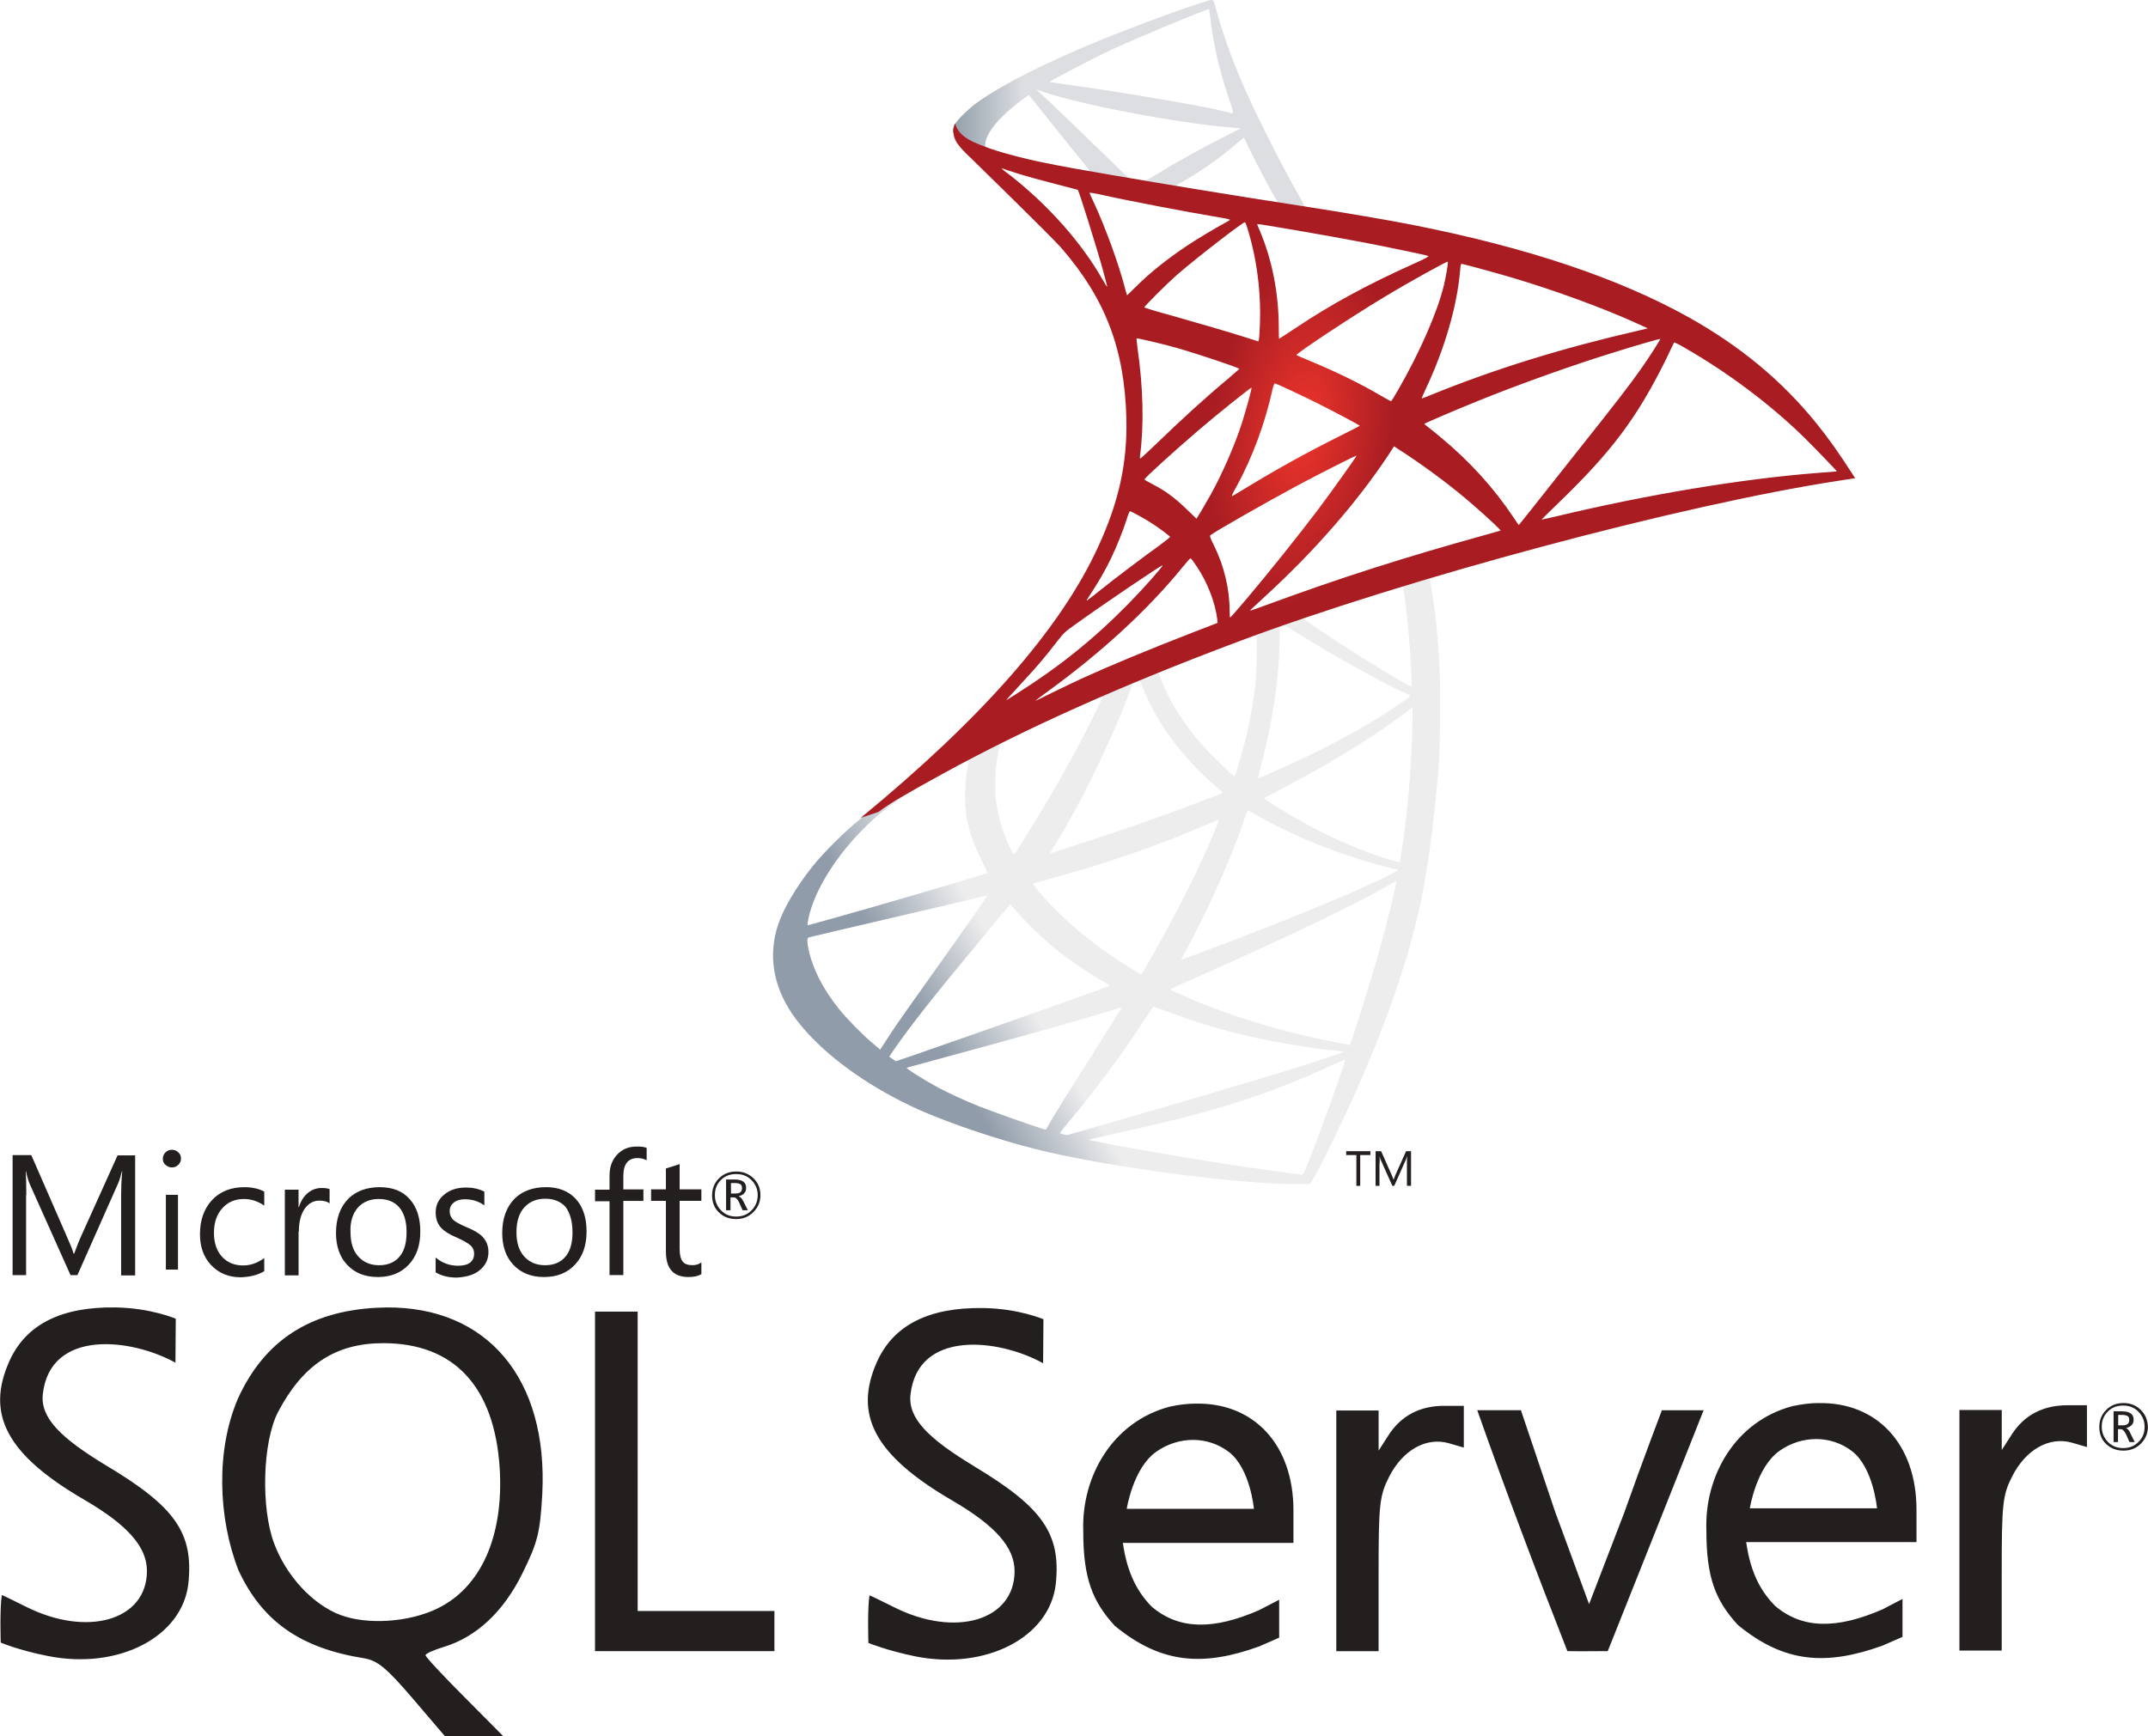
Part-I: From Monolithic to Microservice Modular Application / Polyglot Persistence
Monolithic Application
Module - 1
Module - 2
Module - 3
Module - 4
Module - 5
Module - 6

Slide 15
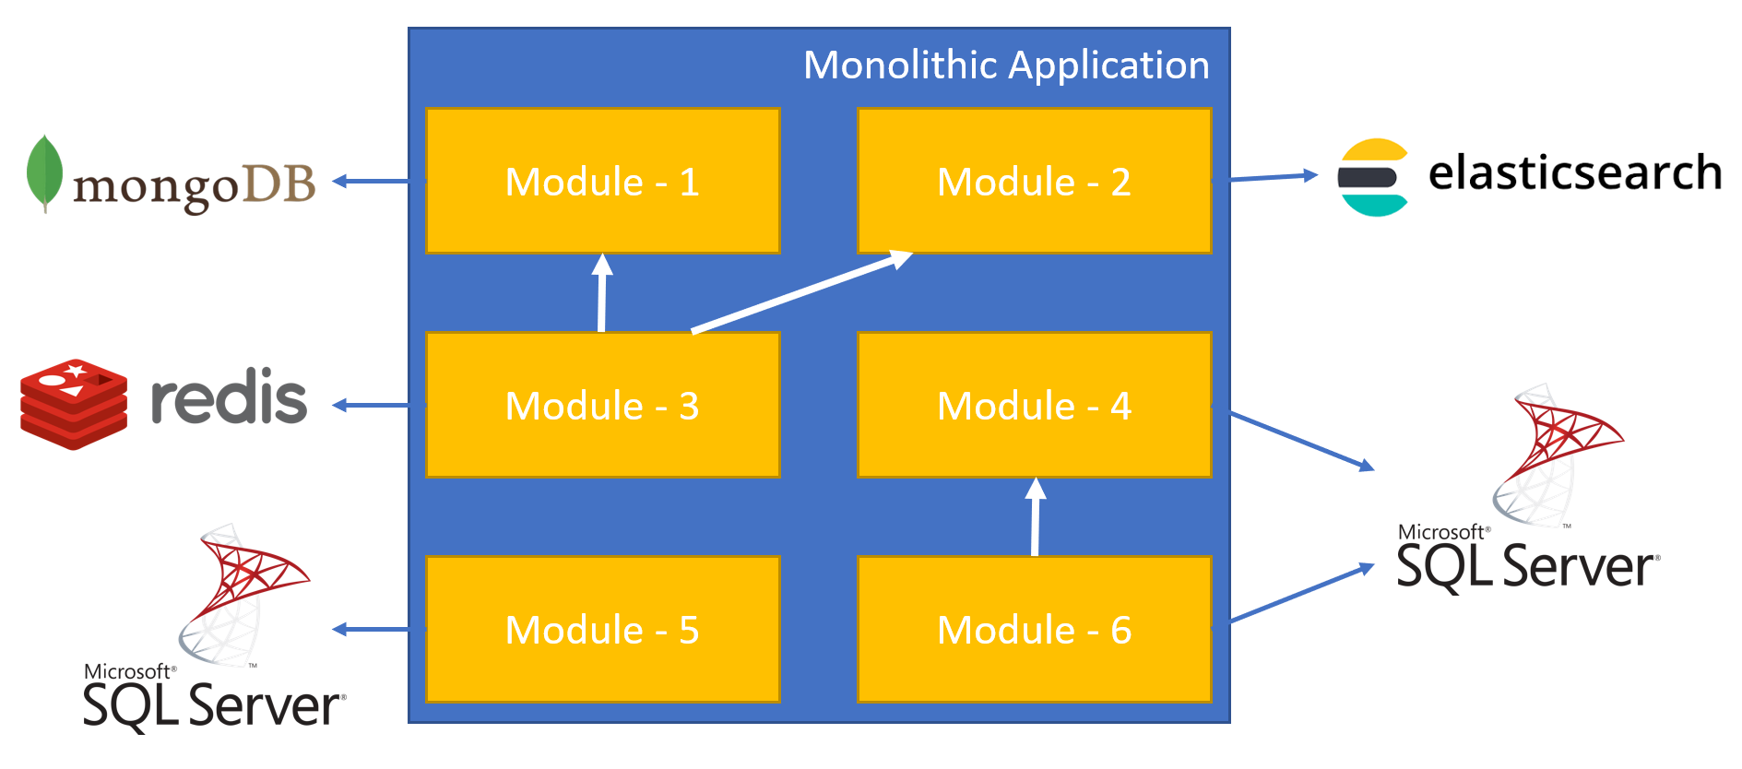
Part-I: From Monolithic to Microservice Modular Application / Separated Databases
Benefits
A module can use the best DBMS for it.
Challenges
Impossible to have cross-database joins and transactions

Slide 16
Part-I: From Monolithic to Microservice Distributed Services (SOA)
Web Application
3rd-Party Clients
server/container
server/container
Service - 1
Service - 3
server/container
Service - 2

Slide 17
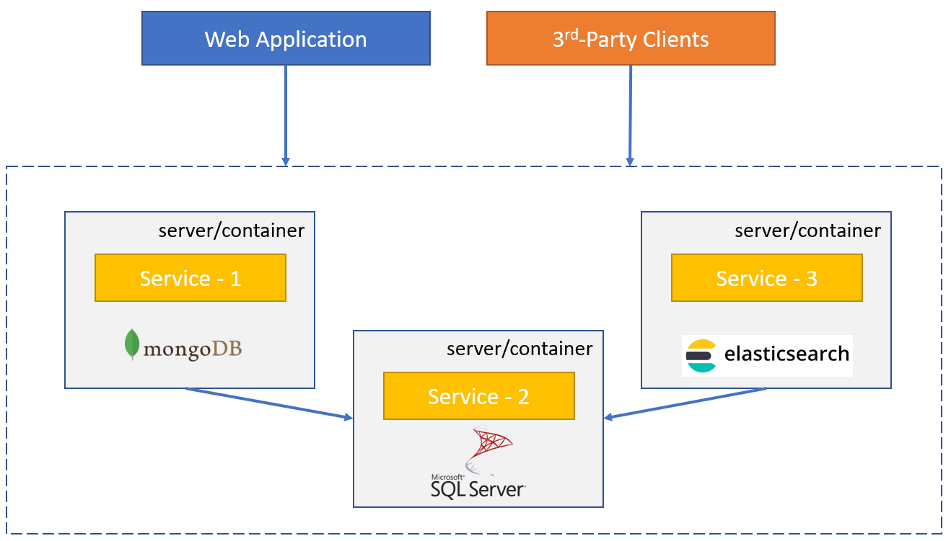
Part-I: From Monolithic to Microservice Modular Application / Separated Databases
Benefits
Better Scalability
Each service gets less load
Each service can be scaled independently
A service can be separately developed, versioned and deployed.
Every service can be developed using a different technology/platform/language as long as they use standard communication protocols (like TCP sockets, REST or GraphQL).

Slide 18
Part-I: From Monolithic to Microservice Modular Application / Separated Databases
Challenges
Complexity of service-to-service communication
Network delays
Security
Service downs
Bottlenecks
Multiple endpoints for clients?
Centralized logging / Tracing Request
Code share may not be possible if you use different platforms (PHP, Java, Dotnet…)

Slide 19
Part-II The Implementation

Slide 20

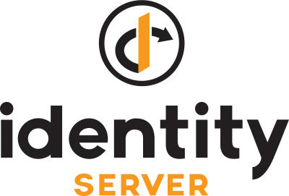




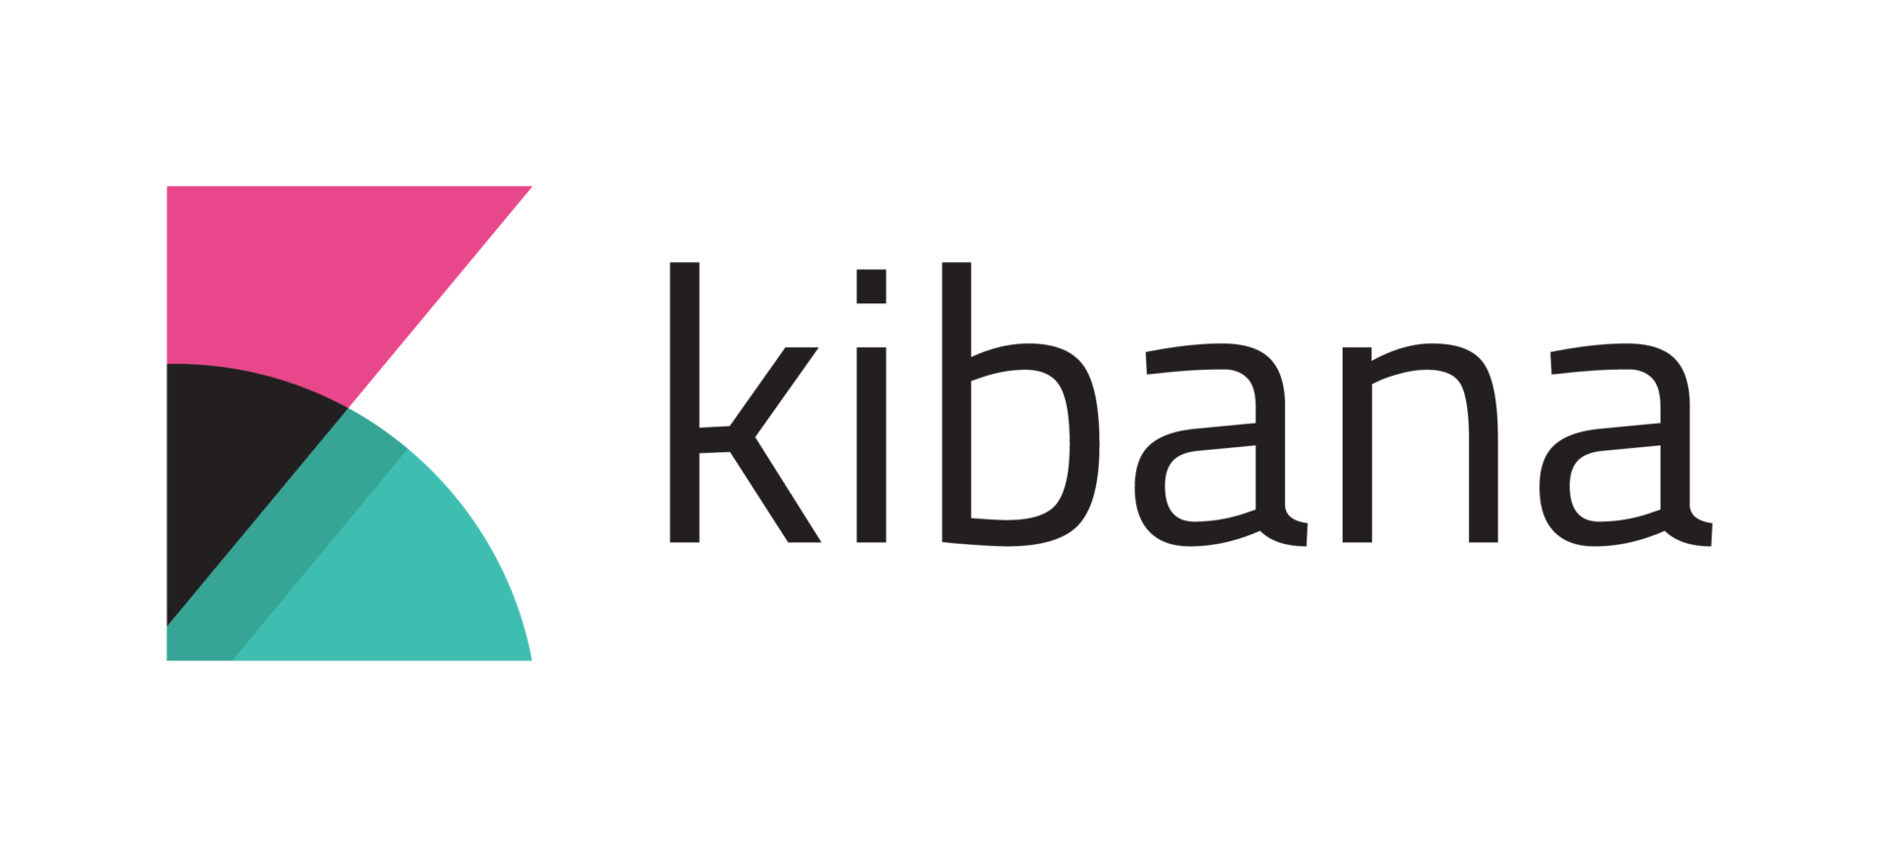
Part-II: The Implementation Overall Solution
Authentication Server
Identity Microservice
Backend Admin Application (MVC)
Backend App
Gateway
Internal
Gateway
Blogging Microservice
Public Web Site
(MVC)
Public Web Site
Gateway
Event Bus
Product Microservice
RabbitMQ
(Distributed Cache)
(Log Database)
(Data Visualization)

Slide 21
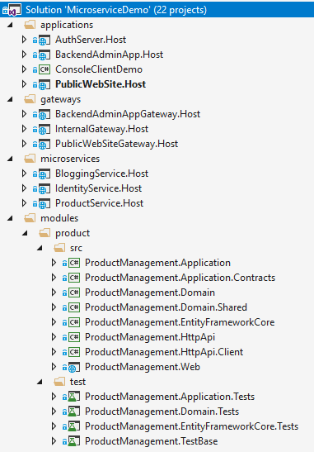
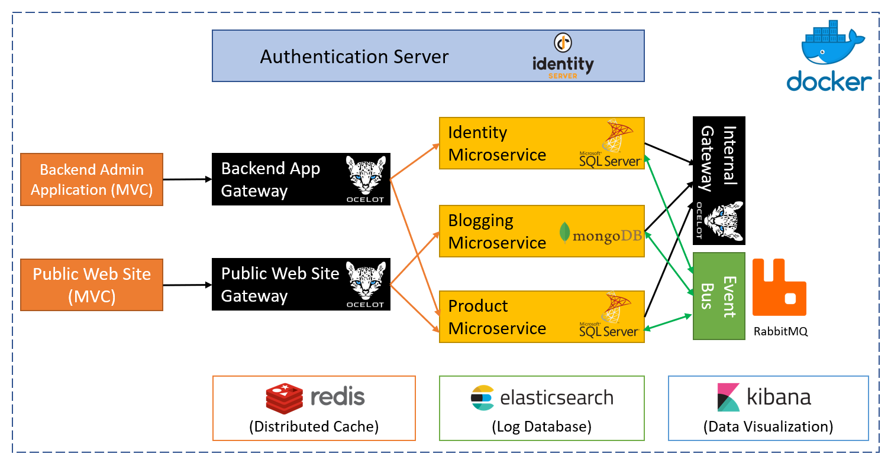
Part-II: The Implementation Overall Solution
Source code: http://bit.ly/ms-demo-source
Documentation: http://bit.ly/ms-demo-doc

Slide 22
Part-II: The Implementation Authentication with IdentityServer4
Open source OpenId Connect & OAuth 2.0 server
Main Features
Authentication as a Service
Access Control for APIs
Single sign on / sign out
User Authentication Flows (used in this solution)
Implicit/Hybrid
Client Secret
https://identityserver.io

Slide 23
Part-II: The Implementation Authentication with IdentityServer4
DEMO

Slide 24
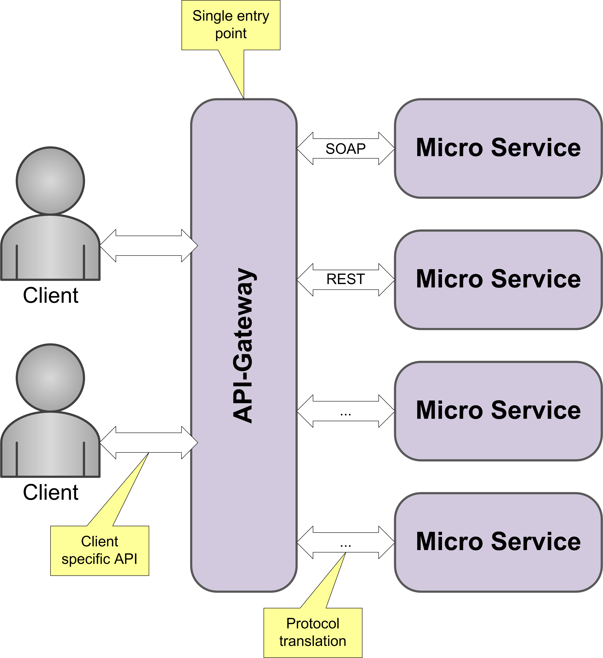
Part-II: The Implementation API Gateways / Overall
Single entrance point to the system for clients
Can be used as load balancer
Can provide;
Authentication
Rate limiting
Auditing
Routing
Protocol translation
…

Slide 25
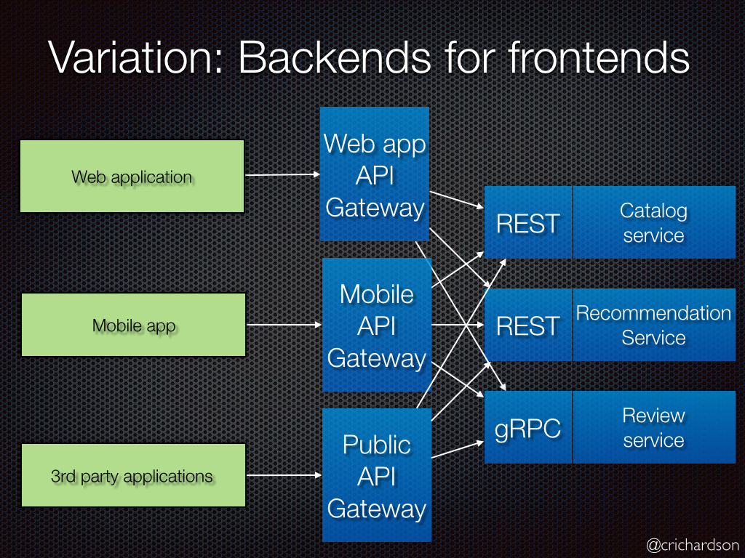
Part-II: The Implementation API Gateways / Backend For Frontend Pattern
Define a separate API Gateway for each kind of client
Each client may require different set of APIs
Each client may require different level of security, performance, logging, rate limiting, communication protocol… etc.
An Internal API Gateway can be used for inter-microservice communication

Slide 26
Part-II: The Implementation API Gateways / Ocelot Library
Open souce API Gateway
Routing
Load Balancing
Rate Limiting
Caching
Retry Policies
Authentication & Authorization
Service Discovery with Consul & Eureka
Request Aggregation
…
http://threemammals.com/ocelot

Slide 27
Part-II: The Implementation API Gateways / Ocelot Library
SHOW CODE

Slide 28
Part-II: The Implementation Synchronous Communication of Microservices
Protocols: REST, SOAP, GraphQL…
Authenticate over IdentityServer
Always use the Internal Gateway
Temporary network/service downs
Retry policies (for GET, PUT & DELETE)
Working with cached/duplicated data
Fallback logic (like async process/return)
Identity Microservice
Blogging Microservice
Internal Gateway
Product Microservice

Slide 29
Part-II: The Implementation Dynamic C# API Proxies
Order Microservice
your code
IProductAppService
Product Microservice
Dynamic ProductAppService Client Proxy
ProductController
REST
(retry)
Http Context
(access_token)
Get auth token
IProductAppService
IAuthenticator
ProductAppService
(Real Implementation)
IProductRepository
OAuth
Authentication Server
Product DB

Slide 30
Part-II: The Implementation Dynamic C# API Proxies
SHOW CODE

Slide 31

Part-II: The Implementation Asynchronous Communication / Messaging
Sender Service
Message Broker (queue)
Receiver Service
Message Broker (e.g. RabbitMQ):
Ordered delivery (FIFO)
Messaging services may not be online at the same time.
Persistent messages / delivery guarantee

Slide 32
Part-II: The Implementation Asynchronous Communication / Pub-Sub Msg
Subscribing Service 1
Publishing Service
Message Broker (queue)
Subscribing Service 1
Publish messages to a topic
Multiple services may subscribe to same topic
Each subscriber gets a copy of each message
Subscribing Service N

Slide 33
Part-II: The Implementation Asynchronous Communication / Event Bus
ABP Infrastructure
IDistributedEventBus Service
Directly publish an event
AggregateRoot.AddDistributedEvent()
Publish event on save/update
Automatic Events
On Create, Update & Delete of entities
IDistributedEventHandler
Subscribe to and handle events
Identity Microservice
Blogging Microservice
Event Bus
RabbitMQ
Product Microservice

Slide 34
Part-II: The Implementation Asynchronous Communication / Event Bus
DEMO

Slide 35
Part-II: The Implementation Data Duplication, Synchronization & Lookup
Requirements
Blogging has a single UserId and needs to other info (Name, Surname, Email… etc).
REST Call? Can be slow and also leads to a heavy load to the Identity (all services may use it).
Blogging service queries all posts and wants to perform a join in the database for a fast result.
Blogging Microservice
Identity Microservice
Posts Collection
Id
BlogId
Title
Content
CreatorId (UserId)
ReadCount
ViewCount
…
Users Table
Id
UserName
Email
Name
Surname
Password
TwoFactorEnabled
…

Slide 36
Part-II: The Implementation Data Duplication, Synchronization & Lookup
Create a local users collection with only the fields needed.
Blogging Microservice
Identity Microservice
Posts Collection
Id
BlogId
Title
Content
CreatorId (UserId)
ReadCount
ViewCount
…
BlogUsers Collection
Id
UserName
Email
Name
Surname
Users Table
Id
UserName
Email
Name
Surname
Password
TwoFactorEnabled
…
join

Slide 37
Part-II: The Implementation Data Duplication, Synchronization & Lookup
Blogging Service
Identity Service
PostService
UserLookupService
REST
UserLookupController
Insert/delete
UserSynchronizer
(event handler)
update
IDistributedEventBus
Subscribe & receive
publish
Event Bus
RabbitMQ

Slide 38
Part-II: The Implementation Data Duplication, Synchronization & Lookup
SHOW CODE

Slide 39
Part-II: The Implementation Authorization & Permission System
A process of giving permission to a user or client to perform specific actions in the system.
Examples: “Create a product”, “Show a report”, “Delete a user”…
Permissions are not stored in the access token!
Access tokens are sent in every request, so we want to keep it small
Access tokens have relatively long lifetime, but permissions may change more frequently

Slide 40
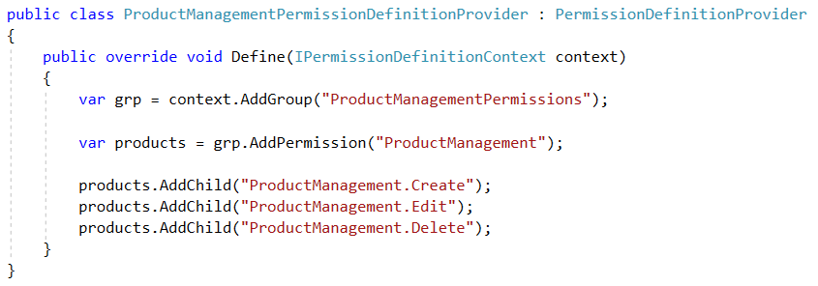
Part-II: The Implementation Authorization & Permission System
ABP has a permission system where any module or service can define and check permissions.

Slide 41
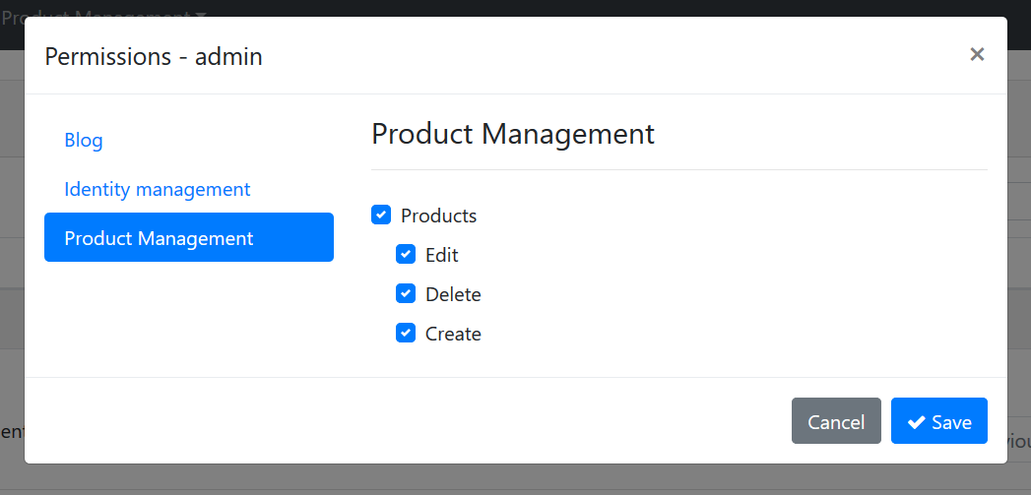
Part-II: The Implementation Authorization & Permission System
ABP has a permission system where any module or service can define and check permissions.

Slide 42
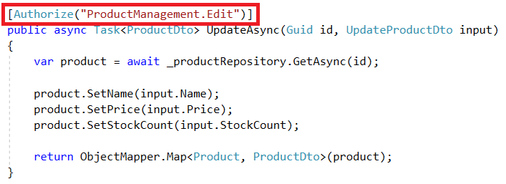
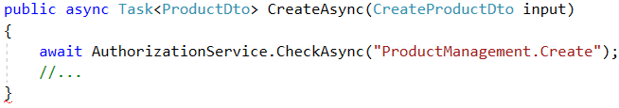
Part-II: The Implementation Authorization & Permission System
ABP has a permission system where any module or service can define and check permissions.

Slide 43
Part-II: The Implementation Service-to-Service Calls / Access Tokens
Authentication Server
Identity Microservice
access
token
Authenticate
(implicit flow)
Authenticate
(client secret flow)
Blogging Microservice
Internal Gateway
access
token
access
token
Public Web Site
(MVC)
Public Web Site
Gateway
access
token
access
token
Product Microservice
access
token

Slide 44
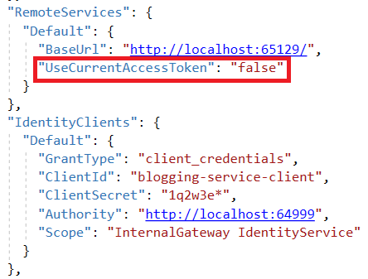
Part-II: The Implementation Service-to-Service Calls / Access Tokens

Slide 45
Part-II: The Implementation Logging to Elasticsearch & Kibana UI
TODO

Slide 46
Part-II: The Implementation Overall Solution

Slide 47
Part-II: The Implementation Overall Solution

Slide 48
Part-II: The Implementation Overall Solution

